Slide 1
Hack4SocialGood
Artificial intelligence as a facilitator of reintegration, not as a risk
Notes:
1

Slide 2

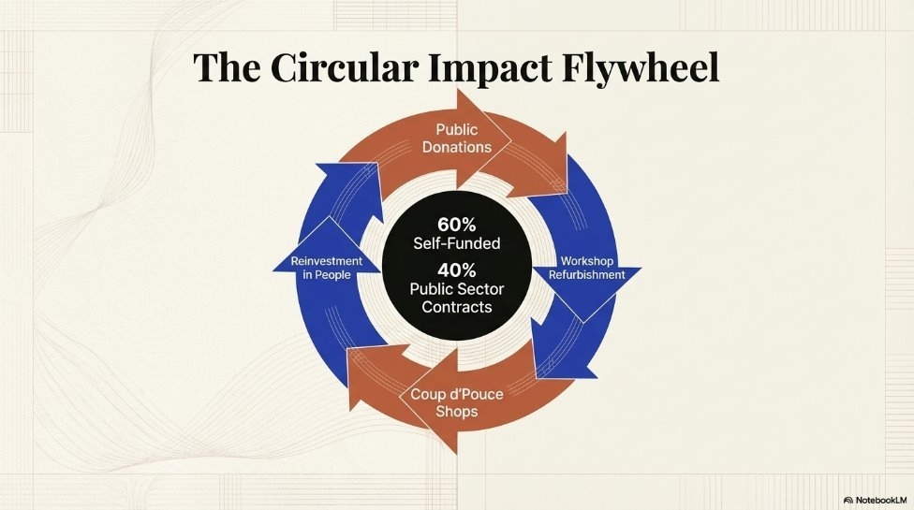
Who are we ?
The Emploi Solidarité Foundation is active in the field of social and professional reintegration and the circular economy through its Coup d’Pouce shops.
On one hand, people in Fribourg donate items such as furniture and clothing, which we refurbish in our workshops and sell in our four second-hand shops.
This enables us to self-fund around 60% of our activities, with the remainder funded through service contracts with the public sector.
On the other hand, it is jobseekers (unemployed, on social assistance or receiving disability benefits) who work in our workshops to refurbish these items. This enables them to develop their professional skills whilst receiving support throughout their process of social and professional reintegration.

Slide 3
Our vision
One of our objectives is the digitalisation of our work, which goes hand in hand with advances in current technologies.
We therefore intend to implement a concept and tools that allow us to use AI as a facilitator in our reintegration work, whilst minimising the risks associated with it, such as the overuse of AI at the expense of our own critical thinking.
Why is it important ?
Our target audience has limited qualifications and is not engaged with (digital) lifelong learning
The administrative burden on our support staff is constantly increasing due to external demands
Support is often limited due to language barriers or a lack of resources
At present, AI tools are still nearly not used by our target audience and virtually non-existent within the Foundation

Slide 4
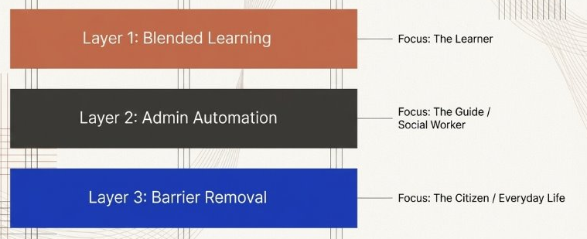
Our challenge

Slide 5
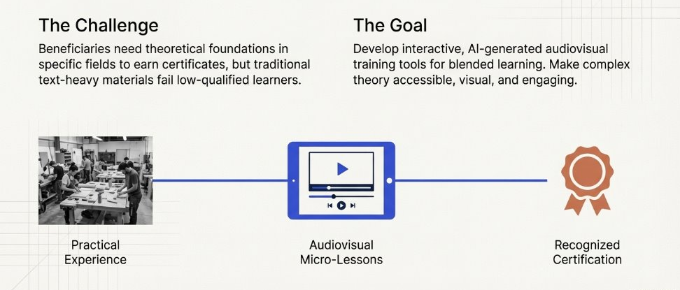
Axis 1 : Blended Learning
This will complement the practical training they receive in our workshops and shops by covering aspects they cannot observe on our premises and by providing theoretical foundations.

Slide 6
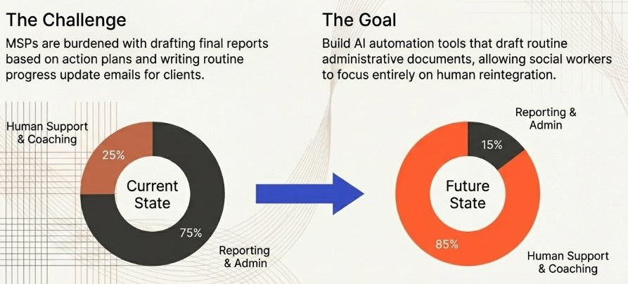
Axis 2 : Admin Automation

Slide 7
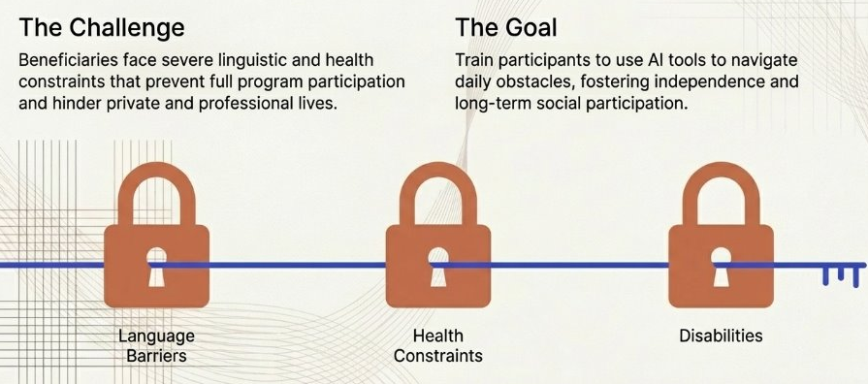
Axis 3 : Barrier Removal

Slide 8

What resources will be made available?
Some typical profiles
Management documents (action plan, etc.)
The blended learning concept for the sales field
The list of tools “under testing”: ChatGPT, DeepL, NotebookLM
Notes:
8

Slide 9
Our requirement
We hope Hack4SocialGoods will help us identify the most suitable AI tools to create teaching materials, address everyday professional challenges, and prepare for a participatory implementation with our team.
As our main client has suspended all investment, we are seeking free or low-cost solutions.
Thank you for your attention !

